Slide 1
人工智慧與資訊安全
Pandas資料分析 學習報告
學生:林佳翰
指導教授:偉大的恩師 龍大大

Slide 2
Agenda
資料科學與Pandas
Pandas資料分析技術(1)
Pandas資料分析技術(2)
Pandas資料專案分析

Slide 3
資料科學與Pandas

Slide 4

資料科學
以一個科學、有系統的工作流程來從原始數據中獲取有用資訊，這種工作模式其實一直都存在。但實行這套工作流程的工具及技術卻在不斷改變。以下這張由數據科學家Drew Conway製作，用於定義數據科學的圖表:
圖中又分為三大部分:數據與統計(Math & Statistics Knowledge)、編程與電腦科學 (Hacking Skills) 以及行業知識
(Substantive Expertise)，從而產生資料科學。
近年又出現R與Python等應用工具的興起改變了舊有的數據分析，像Python和R這兩個用於數據分析的編程語言，
設計非常適合一個電腦科學或數學統計背景出身的人去學習並填補自己缺乏的那一門範疇。現今可收集數據的多元化，
加上分析工具的變遷，把電腦科學和數學統計拉在一起，提升了「從原始數據中獲取有用資訊」這個工作流程的效益。
總結 – Data Science 就是 統計學 + 編程 的強化版
資料引用 http://skycatcheredu.com/%E4%BB%80%E9%BA%BC%E6%98%AF%E6%95%B8%E6%93%9A%E7%A7%91%E5%AD%B8-data-science/

Slide 5
Pandas
Pandas 是pandas是基於NumPy的一種工具，該工具是為了解決數據分析任務而創建的。Pandas納入了大量庫和一些標準的數據模型，提供了高效地操作大型數據集所需的工具。pandas提供了大量能使我們快速便捷地處理數據的函數和方法。你很快就會發現，它是使Python成為強大而高效的數據分析環境的重要因素之一。
python的一個數據分析包，最初由AQR Capital Management於2008年4月開發，並於2009年底開源出來，目前由專注於Python數據包開發的PyData開發team繼續開發和維護，屬於PyData項目的一部分。Pandas最初被作為金融數據分析工具而開發出來，因此，pandas為時間序列分析提供了很好的支持。Pandas的名稱來自於面板數據（panel data）和python數據分析（data analysis）。panel data是經濟學中關於多維數據集的一個術語，在Pandas中也提供了panel的數據類型。
Series：一維數組，與Numpy中的一維array類似。二者與Python基本的數據結構List也很相近。Series如今能保存不同種數據類型，字符串、boolean值、數字等都能保存在Series中。
Time- Series：以時間為索引的Series。
DataFrame：二維的表格型數據結構。很多功能與R中的data.frame類似。可以將DataFrame理解為Series的容器。
Panel ：三維的數組，可以理解為DataFrame的容器。
Panel4D：是像Panel一樣的4維數據容器。
PanelND：擁有factory集合，可以創建像Panel4D一樣N維命名容器的模塊。

Slide 6
Pandas資料分析技術(1)
分層索引

Slide 7
import pandas as pd import numpy as np
載入pands 跟numpy函數
data = pd.Series(np.random.randn(9)
, index=[['a', 'a', 'a', 'b', 'b', 'c', 'c', 'd', 'd'],
[1, 2, 3, 1, 3, 1, 2, 2, 3]])
設定參數值
a 1 -0.959358
2 3.326702
3 -0.730221
b
1 -0.272592
3 -0.787215
c
1 -0.850178
2 -0.843197
d
2 1.045305
3 0.718353 dtype:float64

Slide 8
data.index
進行分層索引
MultiIndex([('a', 1), ('a', 2), ('a', 3), ('b', 1), ('b', 3), ('c', 1), ('c', 2), ('d', 2), ('d',3)], )

Slide 9
data['b']
顯示 B序列裡面的資料
1 -0.272592
3 -0.787215
dtype: float64
data['b': 'c']
顯示B 跟C的資料
b 1 -0.272592
3 -0.787215
c 1 -0.850178
2 -0.843197
dtype: float64

Slide 10
data.loc[['b', 'd']]
利用loc函數取得答案
.loc[],中括號裡面是先行後列，以逗號分割，行和列分別是行標籤和列標籤
b 1 -0.272592
3 -0.787215
d 2 1.045305
3 0.718353
dtype: float64
data.loc[:, 2]
利用loc函數取得答案
a 3.326702
c -0.843197
d 1.045305
dtype: float64

Slide 11
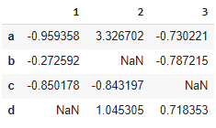
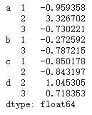
data.unstack()
將DataFrame的行旋轉為列
Stack:將資料的列旋轉為行
Unstack: 將資料的行旋轉為列
Stack和unstack為一組逆向操作
data.unstack().stack()

Slide 12
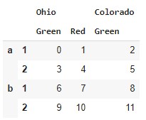
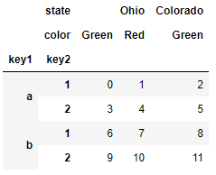
frame = pd.DataFrame(np.arange(12).reshape((4, 3)),
index=[['a', 'a', 'b', 'b'], [1, 2, 1, 2]],
columns=[['Ohio', 'Ohio', 'Colorado'],
['Green', 'Red', 'Green']])
frame
設定dateframe數值與函數
frame.index.names = ['key1', 'key2']
frame.columns.names = ['state', 'color']
新增引索標籤

Slide 13
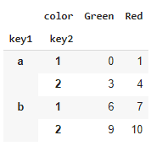

frame [ 'Ohio' ]
顯示Ohio的數值
pd . MultiIndex . from_arrays ([[ 'Ohio' , 'Ohio' , 'Colorado' ], [ 'Green' , 'Red' , 'Green' ]],
names = [ 'state' , 'color' ])
顯示dateframe的分層方式

Slide 14
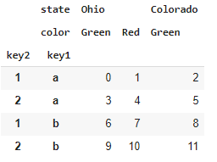
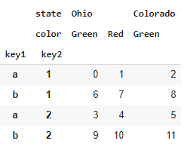
frame . swaplevel ( 'key1' , 'key2' )
設定KEY1跟KEY2的階級
frame . sort_index ( level = 1 )
設定層級排序

Slide 15
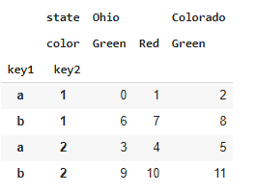
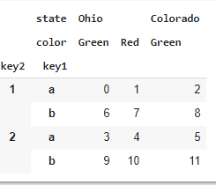
frame . sort_index ( level = 'key2' )
與上列相同為設定索引的層級
frame . swaplevel ( 0 , 1 ) . sort_index ( level = 0 )
以KEY2進行排序

Slide 16
2 Summary Statistics by Level (按層級來歸納統計數據)

Slide 17
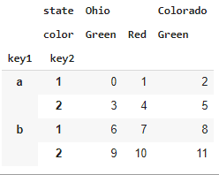
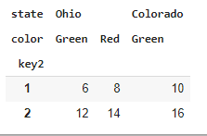
frame
顯示檔案
frame . sum ( level = 'key2' )
按照KEY2來檢索

Slide 18
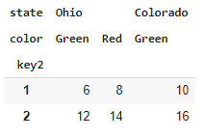
frame . sum ( level = 'color' , axis = 1 )

Slide 19
3 Indexing with a DataFrame's columns（利用DataFrame的列來索引）

Slide 20
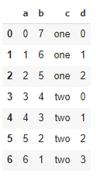
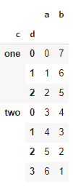
frame = pd . DataFrame ({ 'a' : range ( 7 ), 'b' : range ( 7 , 0 , - 1 ),
'c' : [ 'one' , 'one' , 'one' , 'two' , 'two' ,
'two' , 'two' ],
'd' : [ 0 , 1 , 2 , 0 , 1 , 2 , 3]})
frame
frame2 = frame . set_index ([ 'c' , 'd' ])
frame2
新增新的引索

Slide 21
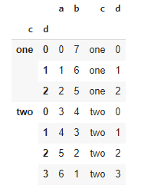
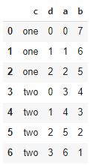
frame . set_index ([ 'c' , 'd' ], drop = False )
保留原本的引索
frame2 . reset_index ()
重新設定引索

Slide 22
Pandas資料分析技術(2)
數據匯總和組操作

Slide 23
1 GroupBy Mechanics（分組機制）

Slide 24
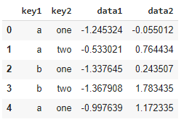
import numpy as np
import pandas as pd
df = pd . DataFrame ({ 'key1' : [ 'a' , 'a' , 'b' , 'b' , 'a' ],
'key2' : [ 'one' , 'two' , 'one' , 'two' , 'one' ],
'data1' : np . random . randn ( 5 ),
'data2' : np . random .randn ( 5 )})
df
載入參數資料

Slide 25

grouped = df [ 'data1' ] . groupby ( df [ 'key1' ])
grouped
<pandas.core.groupby.generic.SeriesGroupBy object at 0x7fc9f32becf8>
按key1來進行分組，但只保留data1這一列
grouped . mean ()
查看已分組資料

Slide 26

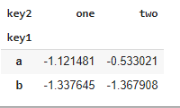
means = df [ 'data1' ] . groupby ([ df [ 'key1' ], df [ 'key2' ]]) . mean ()
means
如上述我們新增一個資料便會產生不同的答案
means . unstack ()
我們利用unstack這個函數去新增新的表格

Slide 27

states = np . array ([ 'Ohio' , 'California' , 'California' , 'Ohio' , 'Ohio' ])
years = np . array ([ 2005 , 2005 , 2006 , 2005 , 2006 ])
df [ 'data1' ] . groupby ([ states , years ]) . mean ()
新增新的數值
df [ 'data1' ] . groupby ([ states , years ])
將資料進行分組
<pandas.core.groupby.generic.SeriesGroupBy object at 0x7fc9f2a8a828>

Slide 28
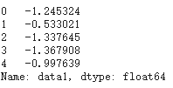
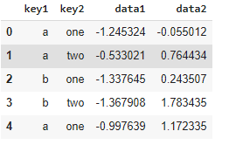
df [ 'data1' ]
確認新的分組資料
df
輸出資料

Slide 29
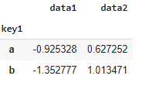
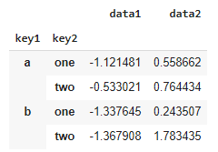
df . groupby ( 'key1' ) . mean ()
查看分組KEY1資料
df . groupby ([ 'key1' , 'key2' ]) . mean ()
查看分組KEY1和KEY2資料

Slide 30
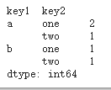
df . groupby ([ 'key1' , 'key2' ]) . size ()
設定資料字體大小

Slide 31
2 Iterating Over Groups（對組進行迭代）

Slide 32
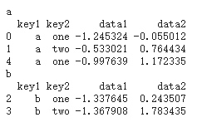
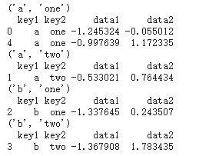
for name , group in df . groupby ( 'key1' ):
print ( name )
print ( group )
對分組進行迭代
Name 為key1 的值
Group 為要輸出的值
for ( k1 , k2 ), group in df . groupby ([ 'key1' , 'key2' ]):
print (( k1 , k2 ))
print ( group )
同理對多組進行迭代

Slide 33
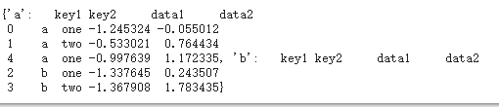

pieces = dict ( list ( df . groupby ( 'key1' )))
pieces
對分組過後資料進行整合
pieces [ 'b' ]
顯示B的答案進行確認

Slide 34

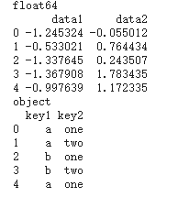
df . dtypes
grouped = df . groupby ( df . dtypes , axis = 1 )
for dtype , group in grouped :
print ( dtype )
print ( group )
分組是在axis預設值為0進行分組
也可以通過更改設定在其他軸進行分組

Slide 35
3 Selecting a Column or Subset of Columns (選中一列，或列的子集)

Slide 36
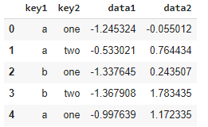
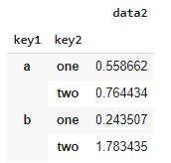
df
df . groupby ([ 'key1' , 'key2' ])[[ 'data2' ]] . mean ()
對KEY1 與key2 中的資料進行聚合 產生出新的df

Slide 37
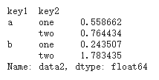
s_grouped = df . groupby ([ 'key1' , 'key2' ])[ 'data2' ]
s_grouped
<pandas.core.groupby.generic.SeriesGroupBy object at 0x7fc9f29d7780>
重設一個分組為data2
s_grouped . mean ()

Slide 38
4 Grouping with Dicts and Series（用Dicts與Series進行分組）

Slide 39
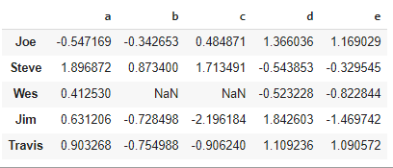
people = pd . DataFrame ( np . random . randn ( 5 , 5 ),
columns = [ 'a' , 'b' , 'c' , 'd' , 'e' ],
index = [ 'Joe' , 'Steve ' , 'Wes' , 'Jim' , 'Travis' ])
people . iloc [ 2 : 3 , [ 1 , 2 ]] = np . nan # Add a few NA values
設定參數資料
people

Slide 40
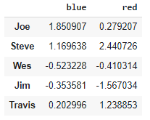
mapping = { 'a' : 'red' , 'b' : 'red' , 'c' : 'blue' ,
'd' : 'blue' , 'e' : 'red' , 'f' : 'orange' }
by_column = people . groupby ( mapping , axis = 1 )
by_column . sum ()
透過dict 函數建構一組資料傳給group by 進行分組

Slide 41
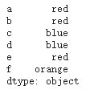
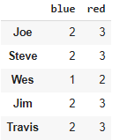
map_series = pd . Series ( mapping )
map_series
透過series 固定輸出範圍
people . groupby ( map_series , axis = 1 ) . count ()

Slide 42
5 Grouping with Functions（用函數進行分組）

Slide 43

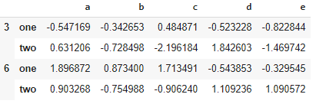
people . groupby ( len ) . sum ()
按照 人名的長度進行分組 只需輸入len即可
key_list = [ 'one' , 'one' , 'one' , 'two' , 'two' ]
將函數 陣列 列表 字典 和series混合使用也沒有關係
最後都會把資料轉成陣列
people . groupby ([ len , key_list ]) . min ()

Slide 44
6 Grouping by Index Levels（按索引層級來分組）

Slide 45
columns = pd . MultiIndex . from_arrays ([[ 'US' , 'US' , 'US' , 'JP' , 'JP' ],
[ 1 , 3 , 5 , 1 , 3 ]],
names = [ 'cty' , 'tenor' ])
columns
MultiIndex([('US', 1),
('US', 3),
('US', 5),
('JP', 1),
('JP', 3)],
names=['cty', 'tenor'])
設定參數

Slide 46
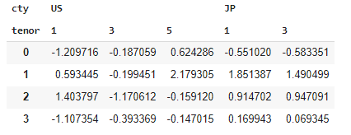
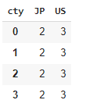
hier_df = pd . DataFrame ( np . random . randn ( 4 , 5 ), columns = columns )
hier_df
根據引索等級分組
指定引數level=即可
hier_df . groupby ( level = 'cty' , axis = 1 ) . count ()

Slide 47
Pandas資料專案分析
2012 Federal Election Commission Database (2012聯邦選舉委員會數據庫)

Slide 48
import numpy as np
import pandas as pd
載入 numpy 與pandas套件
pd.options.display.max_rows = 10
設定字體大小
!wget https://raw.githubusercontent.com/wesm/pydata-book/2nd-edition/datasets/fec/P00000001-ALL.csv
載入所要的資料庫
fec = pd.read_csv('P00000001-ALL.csv', low_memory=False)
定義fec參數

Slide 49
fec.info()
產生出資料的詳細資訊
<class 'pandas.core.frame.DataFrame'>
RangeIndex: 1001731 entries, 0 to 1001730
Data columns (total 16 columns):
# Column Non-Null Count Dtype
--- ------ -------------- -----
0 cmte_id 1001731 non-null object
1 cand_id 1001731 non-null object
2 cand_nm 1001731 non-null object
3 contbr_nm 1001731 non-null object
4 contbr_city 1001712 non-null object
5 contbr_st 1001727 non-null object
6 contbr_zip 1001620 non-null object
7 contbr_employer 988002 non-null object
8 contbr_occupation 993301 non-null object
9 contb_receipt_amt 1001731 non-null float64
10 contb_receipt_dt 1001731 non-null object
11 receipt_desc 14166 non-null object
12 memo_cd 92482 non-null object
13 memo_text 97770 non-null object
14 form_tp 1001731 non-null object
15 file_num 1001731 non-null int64
dtypes: float64(1), int64(1), object(14)
memory usage: 122.3+ MB

Slide 50
fec.head(5)
呼叫出前面5列的資料
cmte_id | cand_id | cand_nm | contbr_nm | contbr_city | contbr_st | contbr_zip | contbr_employer | contbr_occupation | contb_receipt_amt | contb_receipt_dt | receipt_desc | memo_cd | memo_text | form_tp | file_num | party
0 | C00410118 | P20002978 | Bachmann, Michelle | HARVEY, WILLIAM | MOBILE | AL | 366010290 | RETIRED | RETIRED | 250.0 | 20-JUN-11 | NaN | NaN | NaN | SA17A | 736166 | Republican
1 | C00410118 | P20002978 | Bachmann, Michelle | HARVEY, WILLIAM | MOBILE | AL | 366010290 | RETIRED | RETIRED | 50.0 | 23-JUN-11 | NaN | NaN | NaN | SA17A | 736166 | Republican
2 | C00410118 | P20002978 | Bachmann, Michelle | SMITH, LANIER | LANETT | AL | 368633403 | NOT PROVIDED | NOT PROVIDED | 250.0 | 05-JUL-11 | NaN | NaN | NaN | SA17A | 749073 | Republican
3 | C00410118 | P20002978 | Bachmann, Michelle | BLEVINS, DARONDA | PIGGOTT | AR | 724548253 | NONE | RETIRED | 250.0 | 01-AUG-11 | NaN | NaN | NaN | SA17A | 749073 | Republican
4 | C00410118 | P20002978 | Bachmann, Michelle | WARDENBURG, HAROLD | HOT SPRINGS NATION | AR | 719016467 | NONE | RETIRED | 300.0 | 20-JUN-11 | NaN | NaN | NaN | SA17A | 736166 | Republican

Slide 51
fec.iloc[123456]
呼叫出我們所需的資料
cmte_id C00431445
cand_id P80003338
cand_nm Obama, Barack
contbr_nm ELLMAN, IRA
contbr_city TEMPE
...
receipt_desc NaN
memo_cd NaN
memo_text NaN
form_tp SA17A
file_num 772372
Name: 123456, Length: 16, dtype: object

Slide 52
unique_cands = fec.cand_nm.unique()
unique_cands
加入黨派
array(['Bachmann, Michelle', 'Romney, Mitt', 'Obama, Barack',
"Roemer, Charles E. 'Buddy' III", 'Pawlenty, Timothy',
'Johnson, Gary Earl', 'Paul, Ron', 'Santorum, Rick',
'Cain, Herman', 'Gingrich, Newt', 'McCotter, Thaddeus G',
'Huntsman, Jon', 'Perry, Rick'], dtype=object)
unique_cands[2]
查看政黨
Obama, Barack

Slide 53
parties = {'Bachmann, Michelle': 'Republican',
'Cain, Herman': 'Republican',
'Gingrich, Newt': 'Republican',
'Huntsman, Jon': 'Republican',
'Johnson, Gary Earl': 'Republican',
'McCotter, Thaddeus G': 'Republican',
'Obama, Barack': 'Democrat',
'Paul, Ron': 'Republican',
'Pawlenty, Timothy': 'Republican',
'Perry, Rick': 'Republican',
"Roemer, Charles E. 'Buddy' III": 'Republican',
'Romney, Mitt': 'Republican',
'Santorum, Rick': 'Republican'}
建立字典
fec.cand_nm[123456:123461]
123456 Obama, Barack
123457 Obama, Barack
123458 Obama, Barack
123459 Obama, Barack
123460 Obama, Barack
Name: cand_nm, dtype: object
查看資料

Slide 54
fec.cand_nm[123456:123461].map(parties)
合併資料
123456 Democrat
123457 Democrat
123458 Democrat
123459 Democrat
123460 Democrat
Name: cand_nm, dtype: object
fec['party'] = fec.cand_nm.map(parties)
fec['party'].value_counts()
Democrat 593746
Republican 407985
Name: party, dtype: int64

Slide 55
設定只呈現捐款資料
(fec.contb_receipt_amt > 0).value_counts()
True 991475
False 10256
Name: contb_receipt_amt, dtype: int64
fec = fec[fec.contb_receipt_amt > 0]
fec_mrbo = fec[fec.cand_nm.isin(['Obama, Barack', 'Romney, Mitt'])]

Slide 56
1 Donation Statistics by Occupation and Employer（按照職業與雇主劃分的捐贈數據)

Slide 57
fec.contbr_occupation.value_counts()[:10]
RETIRED 233990
INFORMATION REQUESTED 35107
ATTORNEY 34286
HOMEMAKER 29931
PHYSICIAN 23432
INFORMATION REQUESTED PER BEST EFFORTS 21138
ENGINEER 14334
TEACHER 13990
CONSULTANT 13273
PROFESSOR 12555
Name: contbr_occupation, dtype: int64

Slide 58
occ_mapping = {
'INFORMATION REQUESTED PER BEST EFFORTS' : 'NOT PROVIDED',
'INFORMATION REQUESTED' : 'NOT PROVIDED',
'INFORMATION REQUESTED (BEST EFFORTS)' : 'NOT PROVIDED',
'C.E.O.': 'CEO'
}
# If no mapping provided, return x
f = lambda x: occ_mapping.get(x, x)
fec.contbr_occupation = fec.contbr_occupation.map(f)

Slide 59
fec.contbr_occupation
0 RETIRED
1 RETIRED
2 NOT PROVIDED
3 RETIRED
4 RETIRED
...
1001726 NOT PROVIDED
1001727 BUSINESS OWNER
1001728 NOT PROVIDED
1001729 LONGWALL MAINTENANCE FOREMAN
1001730 NOT PROVIDED
Name: contbr_occupation, Length: 991475, dtype: object

Slide 60
emp_mapping = {
'INFORMATION REQUESTED PER BEST EFFORTS' : 'NOT PROVIDED',
'INFORMATION REQUESTED' : 'NOT PROVIDED',
'SELF' : 'SELF-EMPLOYED',
'SELF EMPLOYED' : 'SELF-EMPLOYED',
}
# If no mapping provided, return x
f = lambda x: emp_mapping.get(x, x)
fec.contbr_employer = fec.contbr_employer.map(f)

Slide 61
fec.contbr_employer
0 RETIRED
1 RETIRED
2 NOT PROVIDED
3 NONE
4 NONE
...
1001726 NOT PROVIDED
1001727 DUFFY EQUIPMENT COMPANY INC.
1001728 NOT PROVIDED
1001729 T.A.C.C.
1001730 NOT PROVIDED
Name: contbr_employer, Length: 991475, dtype: object

Slide 62
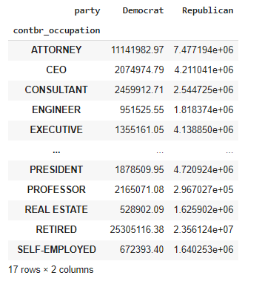
by_occupation = fec.pivot_table('contb_receipt_amt',
index='contbr_occupation',
columns='party',
aggfunc='sum')
over_2mm = by_occupation[by_occupation.sum(1) > 2000000]
over_2mm

Slide 63
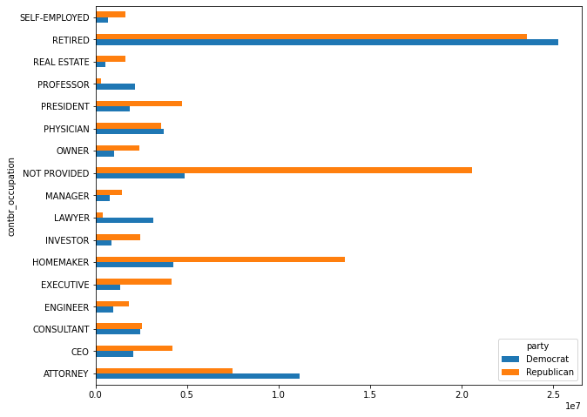
import seaborn as sns
%matplotlib inline
over_2mm.plot(kind='barh', figsize=(10, 8))

Slide 64
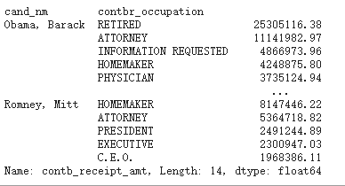
def get_top_amounts(group, key, n=5):
totals = group.groupby(key)['contb_receipt_amt'].sum()
return totals.nlargest(n)
grouped = fec_mrbo.groupby('cand_nm')
grouped
<pandas.core.groupby.generic.DataFrameGroupBy object at 0x7f050434fe10>
grouped.apply(get_top_amounts, 'contbr_occupation', n=7)

Slide 65
grouped.apply(get_top_amounts, 'contbr_employer', n=10)
cand_nm contbr_employer
Obama, Barack RETIRED 22694358.85
SELF-EMPLOYED 17080985.96
NOT EMPLOYED 8586308.70
INFORMATION REQUESTED 5053480.37
HOMEMAKER 2605408.54
...
Romney, Mitt CREDIT SUISSE 281150.00
MORGAN STANLEY 267266.00
GOLDMAN SACH & CO. 238250.00
BARCLAYS CAPITAL 162750.00
H.I.G. CAPITAL 139500.00
Name: contb_receipt_amt, Length: 20, dtype: float64

Slide 66
2 Bucketing Donation Amounts（統捐贈額）

Slide 67
bins = np.array([0, 1, 10, 100, 1000, 10000,
100000, 1000000, 10000000])
labels = pd.cut(fec_mrbo.contb_receipt_amt, bins)
labels
411 (10, 100]
412 (100, 1000]
413 (100, 1000]
414 (10, 100]
415 (10, 100]
...
701381 (10, 100]
701382 (100, 1000]
701383 (1, 10]
701384 (10, 100]
701385 (100, 1000]
Name: contb_receipt_amt, Length: 694282, dtype: category
Categories (8, interval[int64]): [(0, 1] < (1, 10] < (10, 100] < (100, 1000] < (1000, 10000] <
(10000, 100000] < (100000, 1000000] < (1000000, 10000000]]

Slide 68
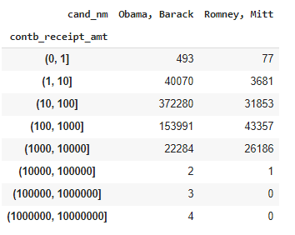
grouped = fec_mrbo.groupby(['cand_nm', labels])
grouped.size().unstack(0)

Slide 69
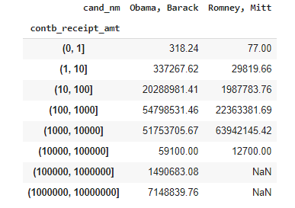
bucket_sums = grouped.contb_receipt_amt.sum().unstack(0)
bucket_sums

Slide 70
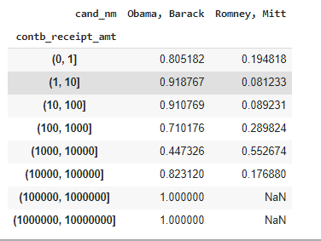
normed_sums = bucket_sums.div(bucket_sums.sum(axis=1), axis=0)
normed_sums

Slide 71
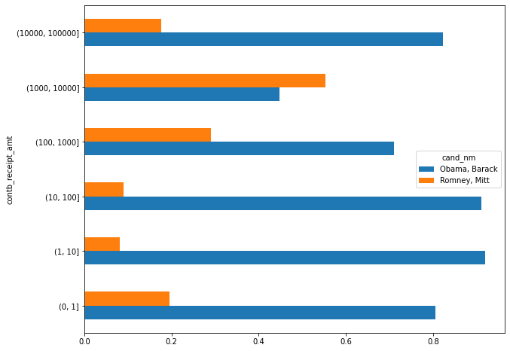
normed_sums[:-2].plot(kind='barh', figsize=(10, 8))

Slide 72
3 Donation Statistics by State（按州劃分的捐贈數據）

Slide 73
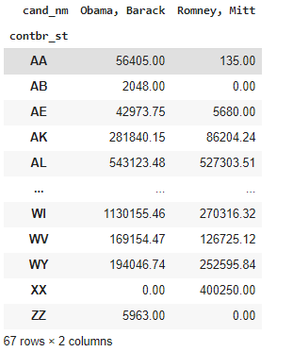
grouped = fec_mrbo.groupby(['cand_nm', 'contbr_st'])
totals = grouped.contb_receipt_amt.sum().unstack(0).fillna(0)
totals

Slide 74
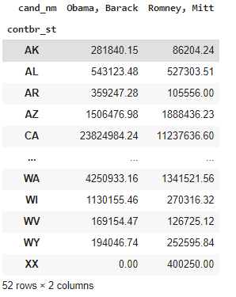
totals = totals[totals.sum(1) > 100000]
totals

Slide 75
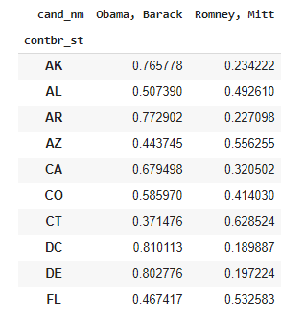
percent = totals.div(totals.sum(1), axis=0)
percent[:10]

